Slide 1


Novy Mart Analysis

Slide 2
Problem Statement
Novy Mart is a retail giant with over 50 supermarkets in the southern region of India. All their 50 stores ran a massive promotion during the Diwali 2023 and Sankranti 2024 (festive time of India) on their Novy branded products. Now the sales director wants to understand which promotions did well and which did not so that they can make informed decisions for their next promotional period.

Slide 3

Provide a list of products with a base price greater than 500 and that are featured in promo type of ‘BOGOF’ (Buy One Get One Free). This information will help us identify high - value products that are currently being heavily discounted, which can be useful for evaluating our pricing and promotion strategies.
Novy Double Bedsheet Set and Novy Waterproof Immersion Rod both are products where the base price is greater than 500 and that are featured in promo type of BOGOF (Buy One Get One Free).

Slide 4
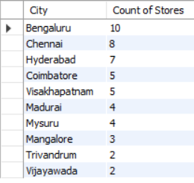
Generate a report that provides an overview of the number of stores in each city. The results will be sorted in descending order of store counts, allowing us to identify the cities with the highest store presence. The report includes two essential fields: city and store count, which will assist in optimizing our retail operations.
There are 10 Stores in Bengaluru City which is highest.
Followed by Chennai city which has 8 stores which is second highest.
Followed by Hyderabad city which has 7 stores which is Third highest.
Followed by Coimbatore, Visakhapatnam, Madurai, Mysuru, Mangalore, Trivandrum, Vijayawada which have no. of stores between 2 and 5.

Slide 5

Generate a report that displays each campaign along with the total revenue generated before and after the campaign? The report includes three key fields: Campaign_Name, Total_Revenue (before_ promotion), Total_Revenue (after_ promotion). This report should help in evaluating the financial impact of our promotional campaigns. (Display the values in millions)
In Diwali Campaign, the company has generated the total revenue before promotion which is 82.57m and the total revenue after promotion which is 207.46m. It represents after promotion is profitable.
In Sankranti Campaign, the company has generated the total revenue before promotion which is 58.13m and the total revenue after promotion which is 140.40m. It represents after promotion is profitable.

Slide 6
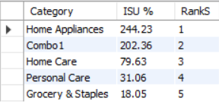
Produce a report that calculates the Incremental Sold Quantity (ISU%) for each category during the Diwali Campaign. Additionally, provide rankings for the categories based on their ISU%. The report will include three key fields: category, isu% and rank order. This information will assist in assessing the category-wise success and impact of the Diwali Campaign on incremental sales.
In Category Home Appliance has generated 244.23 ISU% which is highest.
Followed by Combo 1 has generated 202.36 ISU% which is second highest.
Followed by Home Care has generated 79.63 ISU% which is third highest.
Followed by Personal Care has generated 31.06 ISU% which is forth highest.
Followed by Grocery & Staples has generated 18.05 ISU% which is fifth highest.

Slide 7
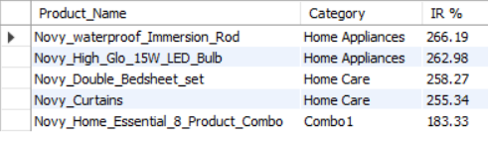
Create a report featuring the Top 5 products, ranked by Incremental Revenue Percentage (IR%), across all campaigns. The report will provide essential information including product name, category and ir%. This analysis helps identify the most successful products in terms of incremental revenue across our campaigns, assisting in product optimization.

Slide 8
Thank You !

